Slide 1

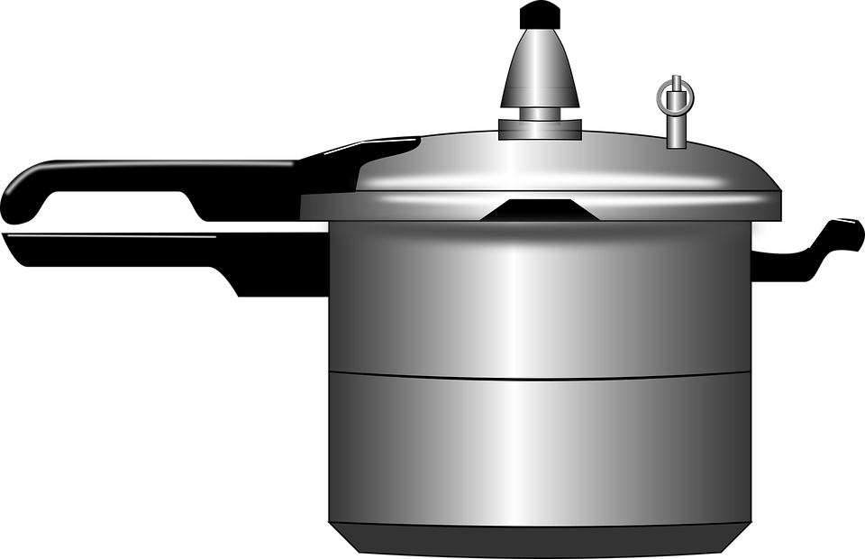
Framework
A Framework is a set of conceptual structure and guidelines, used to build something useful.
Chawal
Daal
Aalu
Gobi
Namak
Haldi
Mirchi
2 Katori Chawal
1 Katori Daal
2 Aalu
4 Gobi
1 Chamach Namak
½ Chamach Haldi
1 Mirchi
khichdi

Slide 2
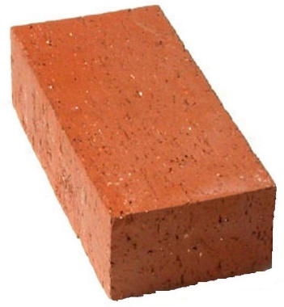
Brick

Slide 3
Framework
A framework may include predefined classes and functions that can be used to process input, manage hardware devices, and interact with system software.
The purpose of the framework is to allow developers to focus on building a unique feature for their Projects rather than writing code from scratch.

Slide 4
Why use Framework
Collection of tools
No need to start from scratch
Save Time
Improve Productivity
Clean Code
Reusable Code
Testing
Debugging

